Slide 1


XV BRICS Summit – Embassy Briefing
Media
25 July 2023

Slide 2
CONTENTS
Background
Media Coverage
Website
Social Media
Media Accreditation
Media Facilities at the venue
Media Centre
Operational info

Slide 3
BACKGROUND
BRICS is a group of leading emerging markets and developing countries, namely Brazil, Russia, India, China and South Africa. The first BRIC Summit was held in 2009 in Russia. South Africa was invited to join in December 2010, forming BRICS. Chairing BRICS follows the sequence of the acronym, so South Africa chaired BRICS in 2013 and 2018.
South Africa became Chair of BRICS on 1 January 2023 under the theme: “BRICS and Africa: Partnership for Mutually Accelerated Growth, Sustainable Development, and Inclusive Multilateralism”. The President has invited his BRICS counterparts to the 15th BRICS Summit, to be held in Sandton, Johannesburg, from 22-24 August 2023.

Slide 4
MEDIA COVERAGE
The media will cover the following sessions:
22 August 2023
Arrivals of Heads of State and Government at designated airports (Photo op)
BRICS Business Forum – report back to BRICS Leaders (Opening remarks)
BRICS Leaders’ Retreat, Sanctuary Mandela, Houghton, Johannesburg (Photo op)
23 August 2023
Arrivals of Heads of State and Government at designated airports (Photo op)
Red carpet arrivals at Sandton ICC (Photo op)
BRICS Family Photo
Opening plenary of the BRICS Summit (Opening remarks)
Press conference
24 August 2023
Red carpet arrivals at Sandton ICC (Photo op)
Family photo
BRICS Africa Outreach and BRICS Plus (Opening remarks)
Press conference
Official media will also cover bilateral meetings involving their delegations (photo ops)

Slide 5
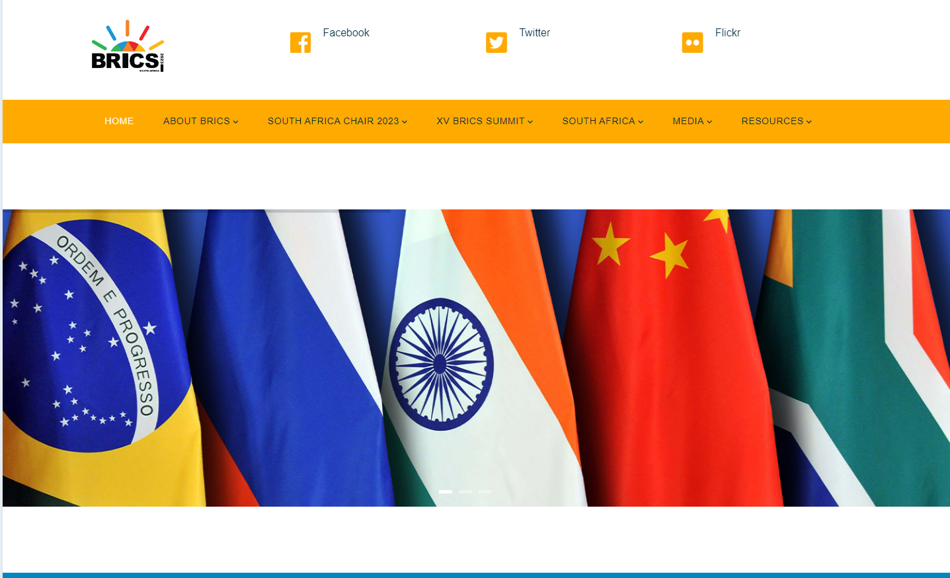
CONFIDENTIAL
WEBSITE
The BRICS website is currently live on www.brics2023.gov.za.
All media information, including accreditation is included on the site.

Slide 6

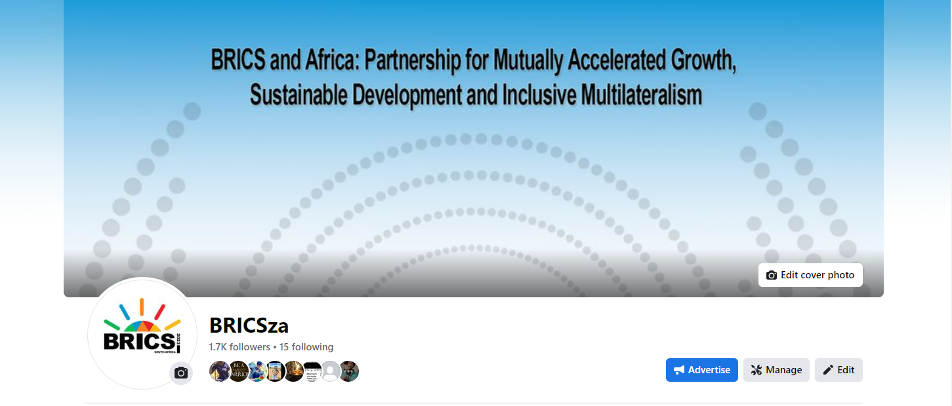
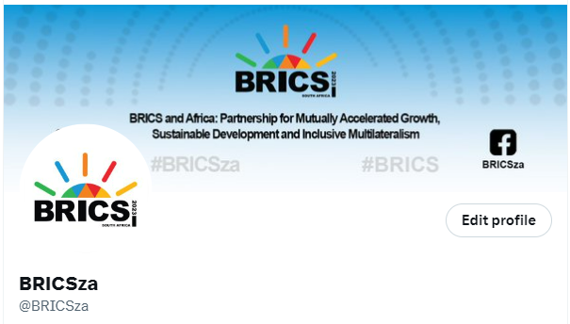
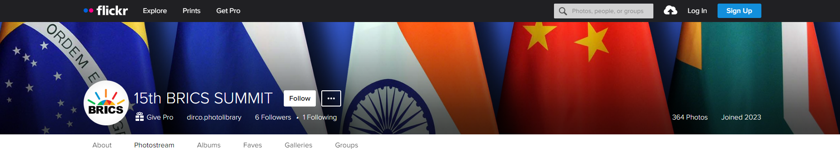
CONFIDENTIAL
SOCIAL MEDIA

Slide 8
MEDIA ACCREDITATION
The media accreditation process opened on Thursday, 29 June 2023
An online system is being used, i.e. https://mrs.gcis.gov.za
The deadline for media accreditation is 11 August 2023. The deadline will not be extended, and late applications will not be accepted
We expect up to 500 media to cover the Summit from the venue
Thus far, we have received 1560 applications for media accreditation
Collection of accreditation cards will be subject to the presentation of a valid ID/Passport and a press card or letter of assignment from the editor
Media accreditation cards will be collected from the Radisson Blu Gautrain hotel in Sandton on a date to be confirmed. This will be days before the Summit, tentatively from 20 August

Slide 9
MEDIA ACCREDITATION…
You will not be able to collect the accreditation card on behalf of your colleague/s
Each delegation can accredit up to three officials as Official Media (photographer, video operator and media liaison officer)
Delegations are advised that officials issued with official media badges will be based in the Media Centre and must perform media duties
Delegations are advised against accrediting officials as media who are not going to perform media duties at the Summit

Slide 10
MEDIA ACCREDITATION…
Passports and visas:
Members of the media from those countries exempted from visa requirements to South Africa need not apply for visas.
All other applicants must comply with the South African visa requirements.
Journalists should contact the nearest South African Diplomatic or Consular Mission to request a South African visa.
Yellow fever certificates will be required at the ports of entry for journalists travelling from yellow fever-designated countries.
Official media travelling on Diplomatic Passports do not require a visa to enter South Africa.
Customs clearance for media equipment:
Accredited media personnel bringing technical equipment with them to South Africa will be subject to full customs control. Journalists are requested to send their lists of equipment (two copies) together with their application for accreditation.
Journalists bringing in heavy equipment that will require space outside of the plenary halls will need to relay this information before 07 August 2023 to the SA Comms team.
Journalists are required to apply for an ATA carnet which is used to clear customs without paying duties and import taxes on merchandise that will be re-exported.

Slide 11
MEDIA FACILITIES
The next slide shows the layout of the Media Centre:
Important to note regarding the Media Centre
All media will enter the venue on foot through Alice Lane (at the back of the Sandton ICC);
Maude Street and Alice Lane will be closed to traffic;
Parking for OB vans will be on Alice Lane;
Space will be allocated for satellites next to the Media Centre;
All broadcasters will be expected to use pool feed provided by the Summit Host Broadcaster;
The Host Broadcaster will provide live, clean feed to other broadcasters;
TV and radio booths are available in the Media Centre;
Booking requests for booths must be channelled to MtshaliP@dirco.gov.za

Slide 12
MEDIA CENTRE

Slide 13
MEDIA CENTRE (Level -2)

Slide 14
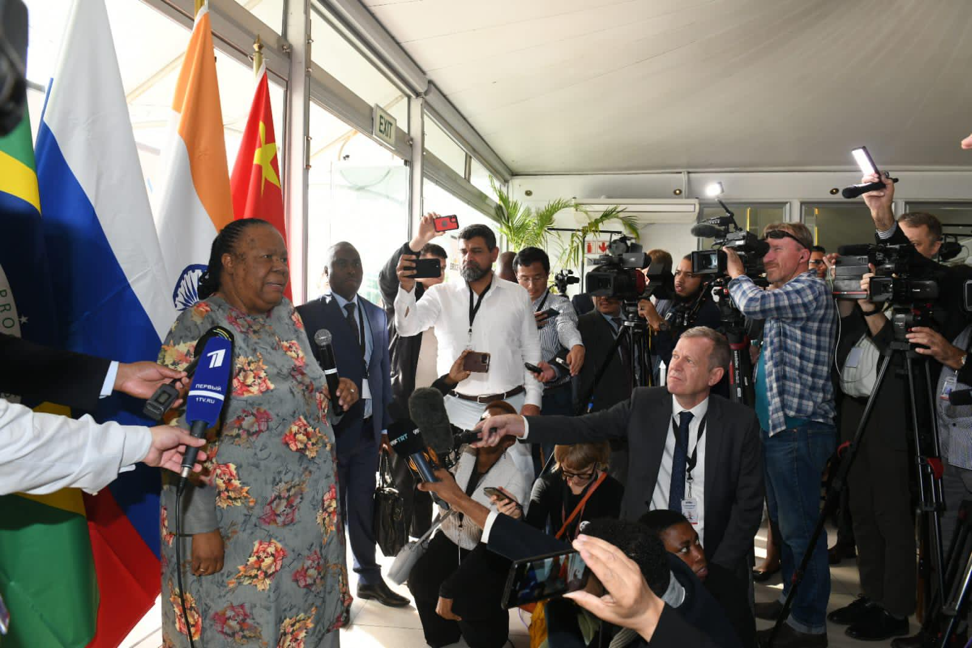

Slide 15
OPERATIONAL INFO
Broadcasters may bring own pull-up banners
The Media Centre will be for the exclusive use of the media
Ministers, Sherpas and other senior officials will use the Media Briefing Room in the Media Centre
Media may set up from Saturday, 19 August 2023
The booths in the media centre will be lockable
There will be a security sweep on Monday, 21 August. The venue will not be accessible to the media on that day
A separate media briefing room will be available for use by Heads of State. The room is shown in the next slide

Slide 16
MEDIA BRIEFING ROOM

Slide 17
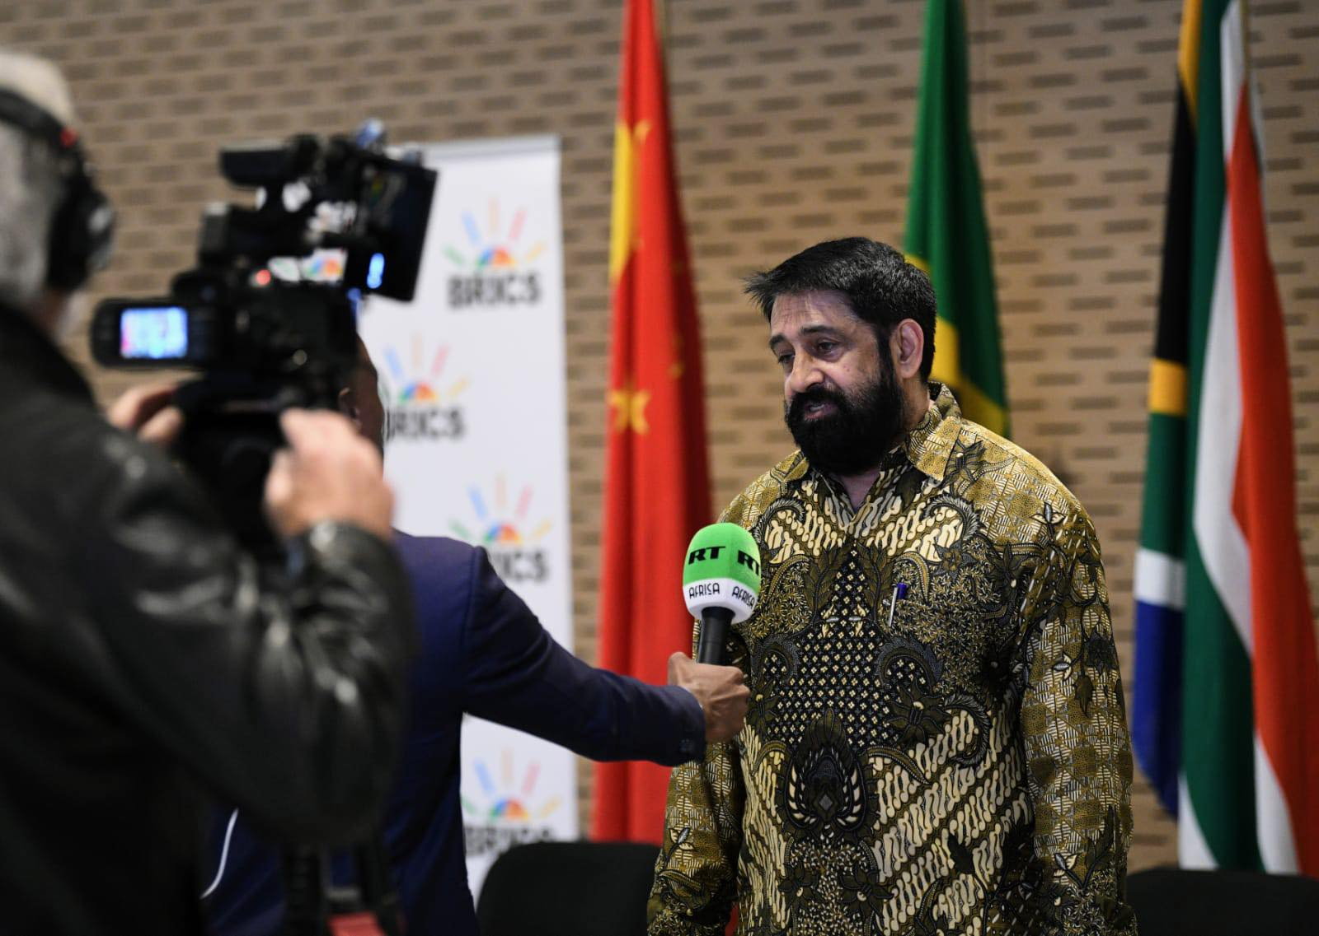

Slide 18
ENQUIRIES
Mr Nelson Kgwete
076 431 3078
kgweten@dirco.gov.za
Ms Patience Mtshali
083 376 9468
mtshalip@dirco.gov.za
Ms Kgopotso Rapakuana
073 058 3876
rapakuanak@dirco.gov.za

Slide 19


